Slide 1
OPTIMAL PLACE FOR OPENING A NEW RESTAURANT IN TORONTO
Final Presentation

Slide 2
Introduction
The restaurant owners need to be very careful when they want to open their branch anywhere because a lot of factors come into play and especially whether they have any competition in that area or not?
They also need to be careful about what other venues are there in that area which could make their sales go higher like a park or station or an office?

Slide 3

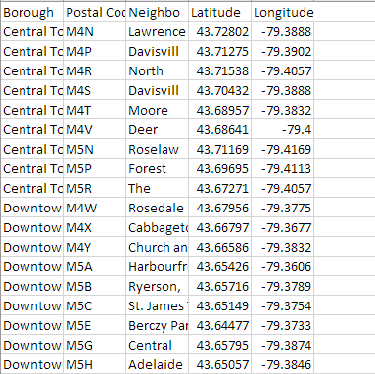
Data
The Data for neighborhoods in Toronto was collected through web scraping of Wikipedia and it was thoroughly preprocessed and cleaned before it could become useful for us
The Data for coordinates was provided in a CSV which was collected through “Geopy” which is a library in python.
The venues were collected using FourSquare API

Slide 4
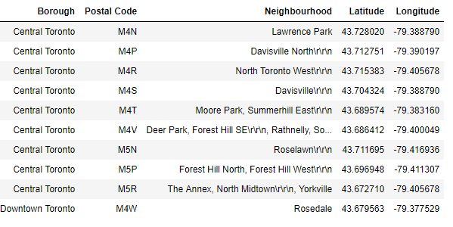
Data Analysis
The Dataset was combined like this

Slide 5
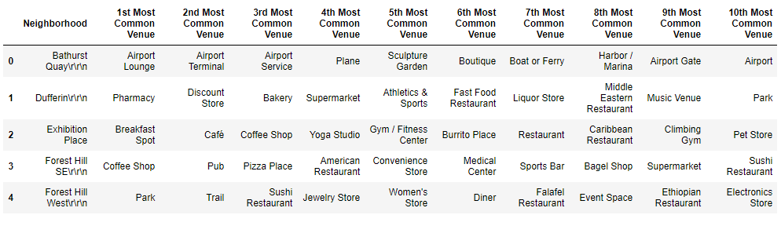
Contd.
After the Foursquare API was used to get venues, The venues for each neighborhood were found and after some coding, the neighborhood with its 10 most common venues were found.

Slide 6
Algorithm
K-Means clustering algorithm was used to cluster different neighborhoods and so that we could deduce which neighborhood could be considered as optimal for the new restaurants

Slide 7
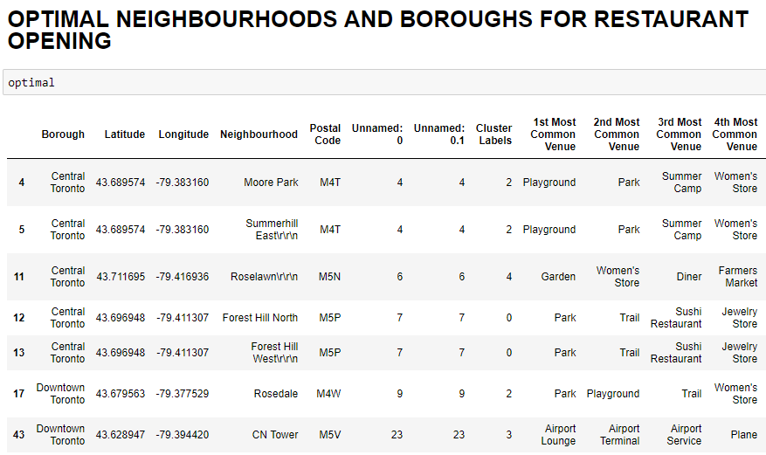
Results
Final result was found which included few neighborhoods which were found to be optimum because they had lesser number of food places and more number of stations, parks and other venues.

Slide 8
Conclusion
This dataset was used to predict an optimal place for a person looking to invest in food business and this can also be used for people who are looking for other businesses like Transportation, Parks, Boutiques or other sort of businesses because results contain a lot of useful other venues information as well

Slide 9
Thankyou

